Slide 1
English
Unit 1 – My World
WALT: Understand, with support most of the main points of short and extended texts.

Slide 2


WALT: Understand, with support most of the main points of short and extended texts.
With support, I can answer comprehension questions on a text.
Independently, I can answer comprehension questions on a text.

Slide 3
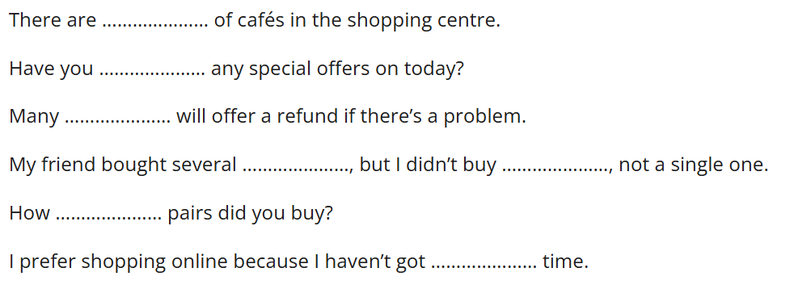
Retrieval Practice
WALT: Understand, with support most of the main points of short and extended texts.
any got many much plenty shops t-shirts
Fill in the sentences with the correct words.

Slide 4
Starter
What is a biography?
WALT: Understand, with support most of the main points of short and extended texts.
A biography is a detailed account of a real person's life written by someone else.

Slide 5
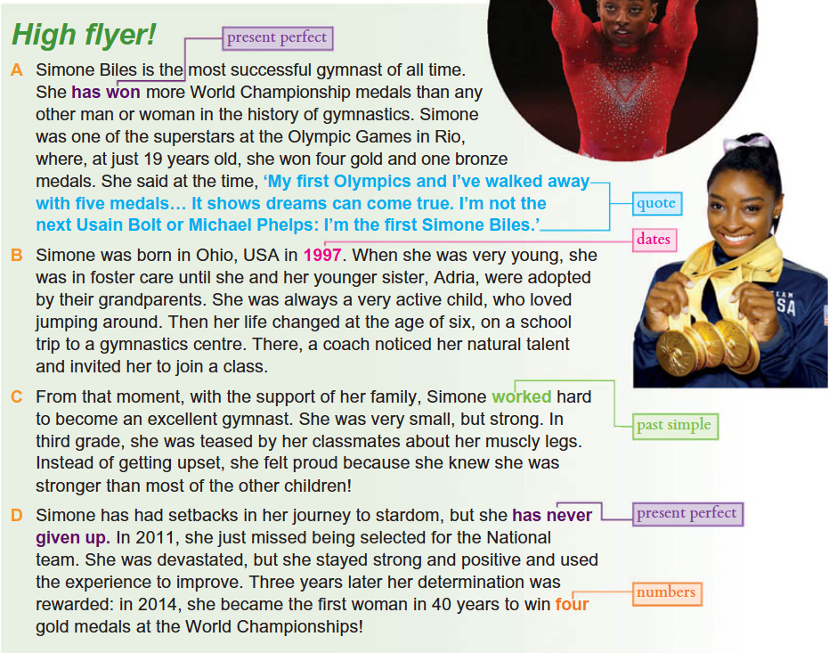
Read the text independently.
WALT: Understand, with support most of the main points of short and extended texts.

Slide 6
I do
Why is Simone Biles considered the most successful gymnast of all time?
WALT: Understand, with support most of the main points of short and extended texts.

Slide 7
We do
How did Simone Biles’s life change when she was 6 years old?
WALT: Understand, with support most of the main points of short and extended texts.

Slide 8
You do
What word has been used to describe a delay or an obstacle faced?
WALT: Understand, with support most of the main points of short and extended texts.

Slide 9
Your task
Where was Simone Biles born, and in what year?
Who adopted Simone and her sister Adria when they were young?
How old was Simone when a coach first discovered her natural talent, and where was she?
How many total medals did Simone win at her first Olympic Games in Rio, and what type were they?
In third grade, classmates teased Simone about her muscly legs. Why was she proud instead of getting upset?
What major setback did Simone face in 2011, and how did she respond to it?
WALT: Understand, with support most of the main points of short and extended texts.

Slide 10
Your task
Simone Biles was born in…
Simone and her sister Adria were adopted by their…
Simone was _______ years old when a coach first discovered her natural talent and she was at…
Simone won ________ medals at her first Olympic Games in Rio
In third grade, classmates teased Simone about her muscly legs. She was proud of her muscly legs because…
In 2011, Simone faced a major setback of… She responded by…
WALT: Understand, with support most of the main points of short and extended texts.

Slide 11
WALT: Understand, with support most of the main points of short and extended texts.
With support, I can answer comprehension questions on a text.
Independently, I can answer comprehension questions on a text.

